Slide 1
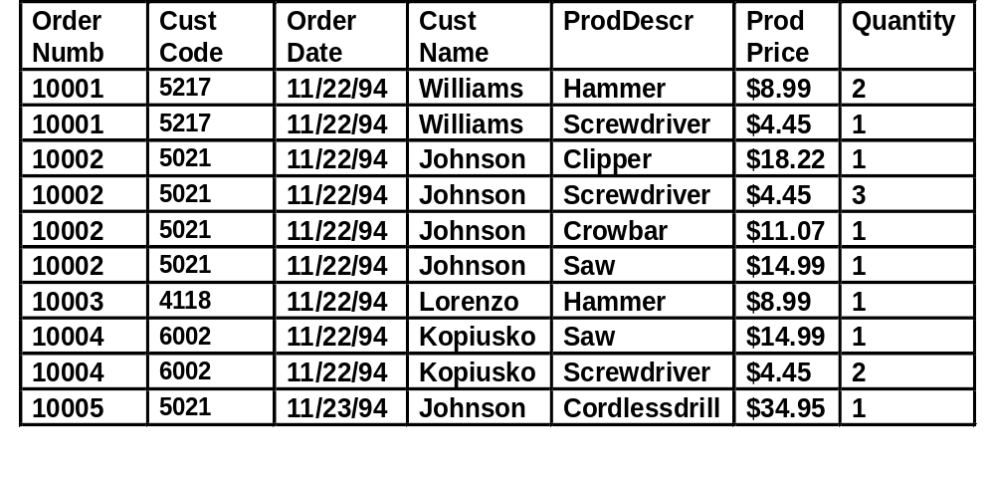
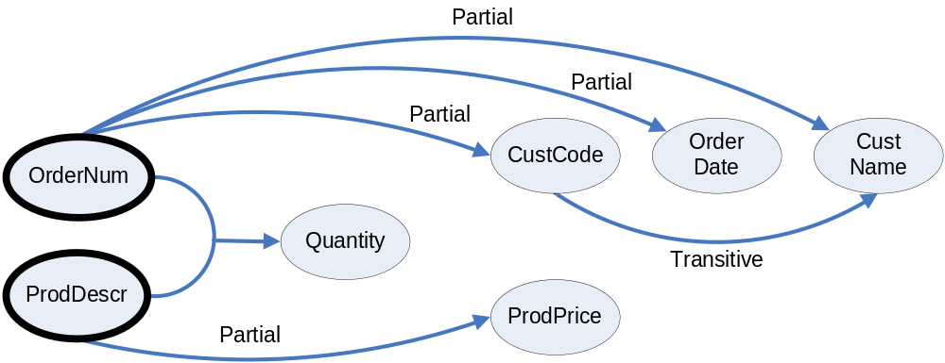
Normalization Example: Hardware Store Database
the ORDERS table :
Note: ideally, we would also want to have product codes or SKU’s as well as descriptions, and use the product codes as keys to identify products. Here, we’ll identify products by their ProdDescr to keep the number of fields small.
What is the primary key for this table? (OrderNumb, ProdDescr)
ORDERS(OrderNum, ProdDescr, CustCode, OrderDate, CustName, ProdPrice, Quantity)

Slide 2
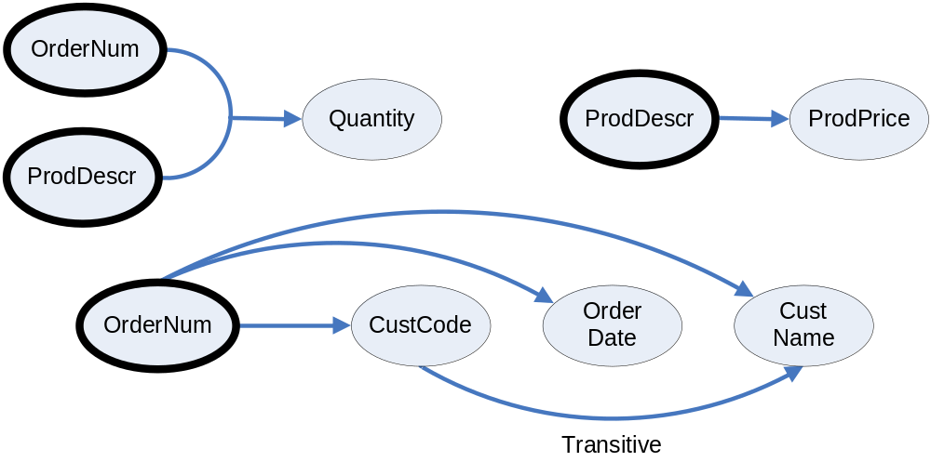
Example: Hardware Store Database (Cont.)
Conversion of the hardware store database to 2NF by splitting tables in order to remove the partial dependencies:
  QUANTITY (OrderNum, ProdDescr, Quantity)
  OrderNum foreign key to ORDERS
  ProdDescr foreign key to PRODUCTS
  PRODUCTS (ProdDescr, ProdPrice)
  ORDERS (OrderNum, CustCode, OrderDate, CustName)

Slide 3
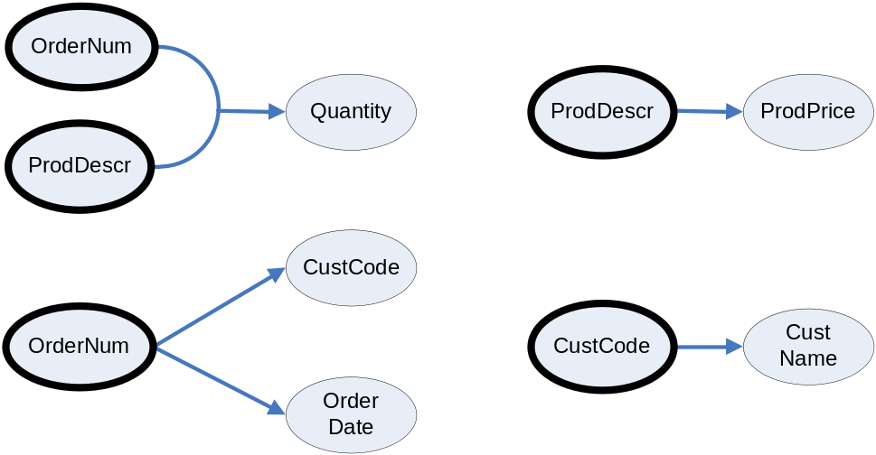
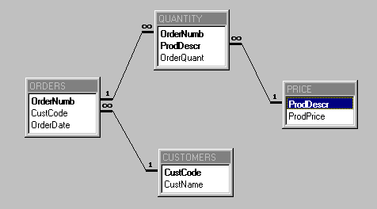
Example: Hardware Store Database (Cont.)
conversion of the ORDERS relation to 3NF by splitting the table in order to remove the transitive dependency:
  QUANTITY(OrderNum, ProdDescr, Quantity)
  OrderNum foreign key to ORDERS
  ProdDescr foreign key to PRODUCTS
  PRODUCTS(ProdDescr, ProdPrice)
  ORDERS(OrderNum, CustCode, OrderDate)
  CustCode foreign key to CUSTOMERS
  CUSTOMERS(CustCode, CustName)

Slide 4
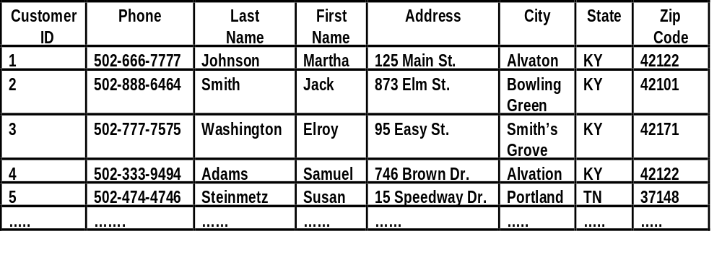
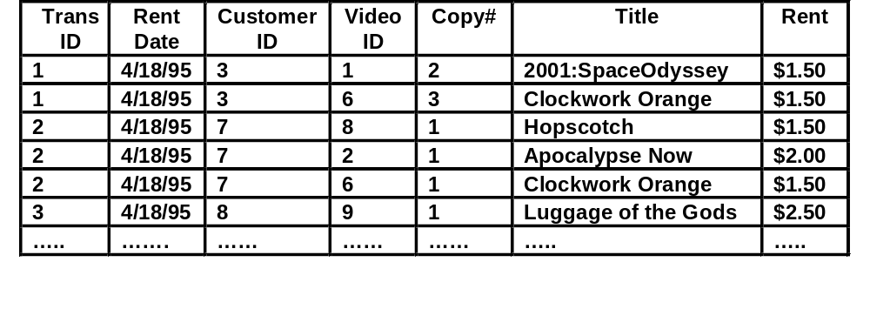
Example: a Video Store Database
the CUSTOMER relation:
the RENTALFORM relation:
  a customer can rent multiple videos as part of the same transaction
  multiple copies of the same video exist
    the copy# field stores the number of the copy – unique only within copies of that same video
    one customer cannot rent two copies of the same video at the same time
  although it already has more than one table, the database still contains some anomalies

Slide 5
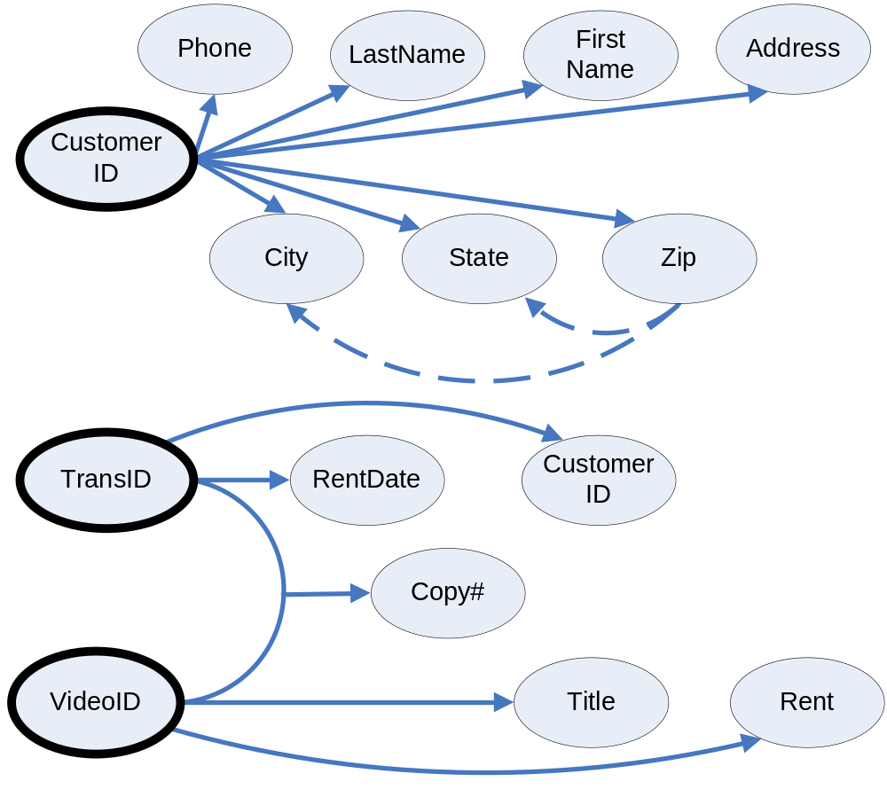
Example: Video Store Database (Cont.)
relations for the video store database
  CUSTOMER(CustomerID,Phone,LastName,FirstName,
  Address, City, State, ZipCode)
  RENTALFORM(TransID, RentDate, CustomerID,
  VideoID, Copy#, Title, Rent)
dependency diagram for the video store database

Slide 6
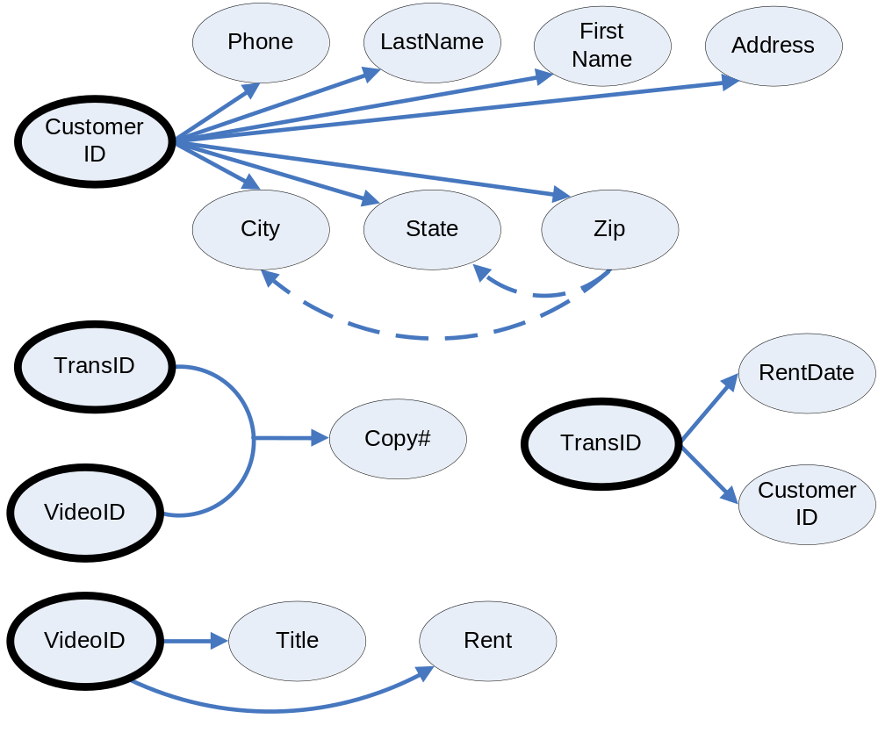
Example: Video Store Database (Cont.)
video store database after eliminating partial and transitive dependencies (except for zip code transitive dependencies)
  CUSTOMER(CustomerID,Phone,LastName,FirstName,
  Address, City, State, ZipCode)
  RENTAL(TransID, RentDate, CustomerID)
  CustomerID foreign key to CUSTOMER
  VIDEO(VideoID, Title, Rent)
  VIDEOSRENTED(TransID, VideoID, Copy#)
  TransID foreign key to RENTAL
  VideoID foreign key to VIDEO

Slide 7
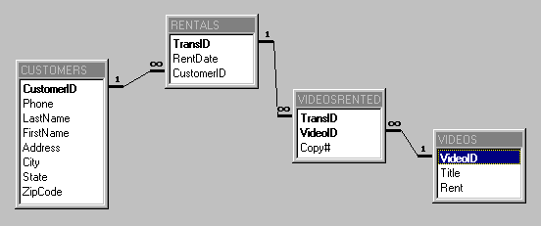
Example: Video Store Database (Cont.)
table relationships for the video store database
Note: if we had access to a zip code table, and thus considered city and state to depend on zip:
  This database would only be in second normal form, since there is a transitive dependency in the CUSTOMERS table
  To eliminate this dependency, we would create a separate ZIPCODES table and remove city and state from the CUSTOMERS table
  Then we would truly be in third normal form
These normalization examples are somewhat simplified.
On the homework, I will give some more complex, realistic examples. Normalizing can be harder than designing from scratch, because
  You have to understand the original design
  You have to “undo” the original design’s incorrect assumptions

